Slide 1

YAY! - Celebrating Education

Slide 2


Python Course
(Basics)

Slide 3
To build a Password Generator in Python!

Slide 4
Agenda for Today
Introduction
What are we going to do?

Slide 5
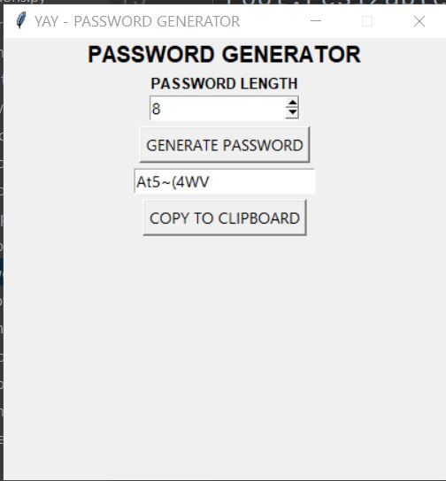
Introduction
The objective of this project is to create a password generator using python. The password generator project will be build using python modules like Tkinter, random, string, pyperclip.
In this project, the user has to select the password length and then click on the “Generate Password” button. It will show the generated password below. If the user clicks on the “Copy To Clipboard” button, then it will copy the password automatically.

Slide 6
Some Prerequisites
To build this project we will use the basic concept of python and libraries – Tkinter, pyperclip, random, string.
Tkinter is a standard GUI library and is one of the easiest ways to build a GUI application.
pyperclip module allows us to copy and paste text to and from the clipboard to your computer
The random module can generate random numbers
string module contains a number of functions to process the standard python string.

Slide 7
What are we going to do?
Let’s check the steps to build a Password Generator using Python
Import modules
Initialized Window
Select Password Length
Define Functions- to generate the password and to copy the password.

Slide 8
What are we going to do?
Initialized Window-
root = Tk()
root.geometry("400x400")
root.resizable(0,0)
root.title(“YAY - PASSWORD GENERATOR")
Tk() initialized tkinter which means window created
geometry() set the width and height of the window
resizable(0,0) set the fixed size of the window
title() set the title of the window

Slide 9
What are we going to do?
Label(root, text = 'PASSWORD GENERATOR' , font ='arial 15 bold').pack()
root is the name which we refer to our window
text which we display on the label
font in which the text is written
pack organized widget in block

Slide 10
What are we going to do?
3. Select Password Length
To select the password length we use Spinbox() widget.
Spinbox() widget is used to select from a fixed number of values.
4.Function to Generate Password
5.Create the buttons
6.Function to copy the password using the button.

Slide 11
Thank You!
See you in the next class!

